Slide 1
Lecture 4: Linear mixed effects models: random model types and diagnostics
Notes are from Robert Bagchi,
University of Connecticut

Slide 2
Mixed model type problems: single random effects
Very common to have MEEs that employ single random effects
These may differ in their complexity,
from
random intercept models (each random group has its own intercept estimate)
to
random slope models (each random group has its own slope estimate)

Slide 3

Radon concentrations in US houses
radon is a naturally occurring radioactive chemical element that causes lung cancer

Slide 4
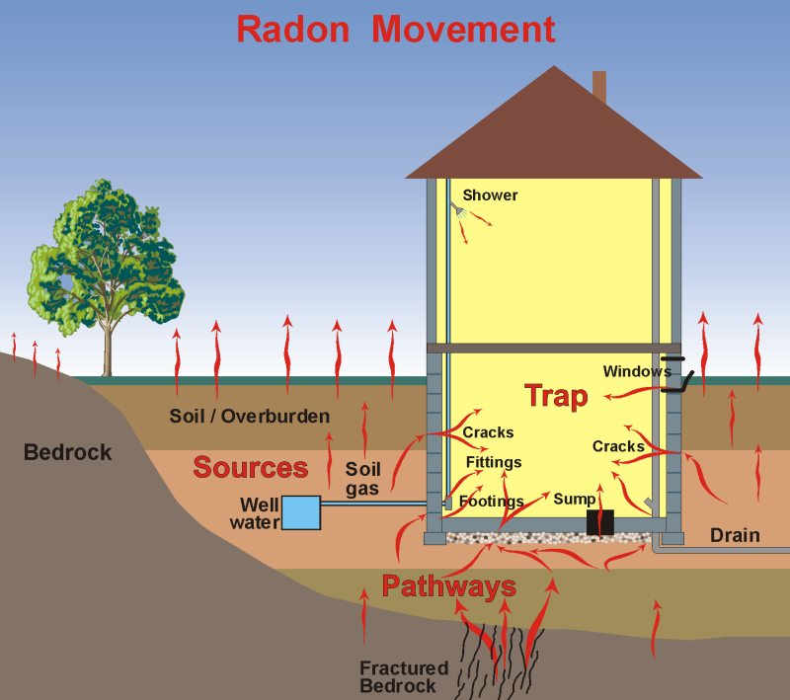
It seeps out of the ground and into our homes

Slide 5
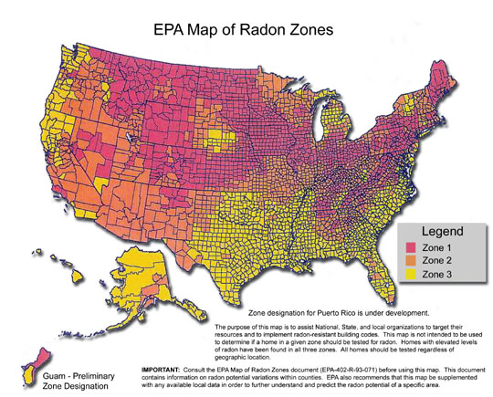
the dataset

Slide 6
Exercise 4.1
Read in the radon data set.
Take a look at the data:
What is the range of radon levels?
How many counties are there?
What does the relationship look like if you plot it? How does it look for different counties?
Fit a linear model to describe the relationship between floor and radon levels.
What is the average radon concentration on the ground floor?
What is the difference between the ground and first floors?
What is the average radon concentration on the first floor?

Slide 7
Fixed vs. random effects
 | Fixed effects | Random effects
Design | Treatments specifically chosen. | Treatments randomly chosen as a representative sample of the “population”
Repetition | If you repeated the experiment you’d use the same levels | You’d use different levels drawn from the same “population”
Desired inference | SPECIFICALLY the levels used | The “population” from which the levels are drawn
Parameters | Estimates | Predictions (Best Linear Unbiased Predictors – BLUPS) Include “shrinkage”
Primary Inference | Means | Variances and Covariances
Mixed effect models include both fixed and random effects

Slide 8
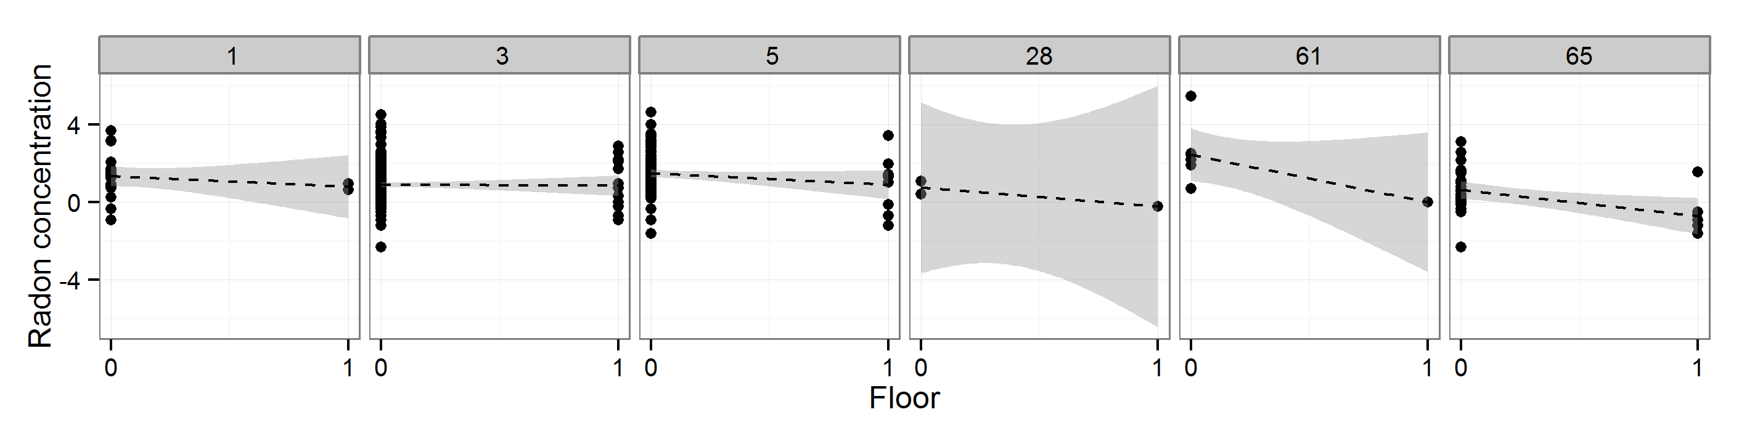
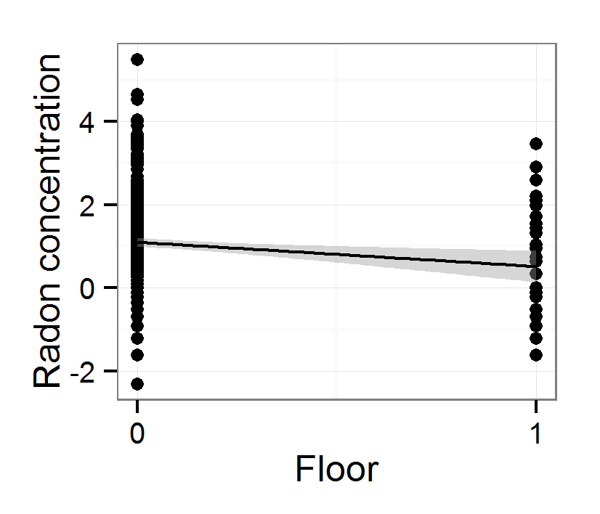
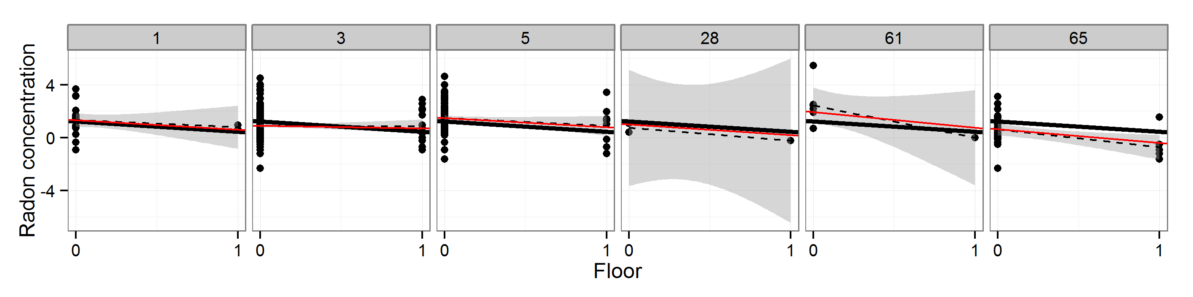
Shrinkage
No pooling – separate lm for each site
Complete pooling – all data together – one linear model
ixed-effects models
Partial pooling –sites with less data to “borrow strength” from the rest of the dataset

Slide 9
Code 4.1
Fitting a mixed effects model with lmer

Slide 10
Linear mixed model fit by REML ['lmerMod'] Formula: radon ~ floor + (1 | county)
Data: radon
Random effects:
Groups Name Variance Std.Dev.
county (Intercept) 0.257 0.507
Residual 1.200 1.095
Number of obs: 2369, groups: county, 68
Fixed effects:
Estimate Std. Error t value
(Intercept) 1.3369 0.0698 19.1
floor -0.7930 0.0751 -10.6
Correlation of Fixed Effects: (Intr)
floor -0.125

Slide 11
What if the effect of floors varies between counties?
Perhaps the difference between floors is greater in some counties than others
To model this, fit a random-slope model
Modify the previous code like this
lmer(radon ~ floor + (1 + floor|county), …)
Grouping factor is still county
The intercept and floor effect are allowed to vary between counties.

Slide 12
Code 4.2
Random slope models with lmer

Slide 13
Linear mixed model fit by REML ['lmerMod']
Formula: radon ~ floor + (1 + floor | county)
Data: radon
REML criterion at convergence: 7282
Scaled residuals:
Min 1Q Median 3Q Max
-3.598 -0.656 -0.053 0.587 4.108
Random effects:
Groups Name Variance Std.Dev. Corr
county (Intercept) 0.2636 0.513
floor 0.0366 0.191 -0.35
Residual 1.1963 1.094
Number of obs: 2369, groups: county, 68
Fixed effects:
Estimate Std. Error t value
(Intercept) 1.3413 0.0706 19.0
floor -0.8115 0.0808 -10.1
Correlation of Fixed Effects:
(Intr)
floor -0.217

Slide 14
Assumptions of LMMs
The model makes biological sense
Additivity and linearity
Independence of errors
Homoscedasticity
Normality of variances– at all levels! (random effects and residual errors)
Can test these with diagnostic plots

Slide 15
Code 4.3
Assessing mixed-effects model fits

Slide 16
Mixed model type problems: Nested random effects
When you have one grouping factor which is subdivided into smaller ones.
Plots within blocks
Pots within a shade-house
Populations within forests
Nested means that multiple cases of one group factor are only found in one case of a larger grouping factor
E.g. If you move pots between shade-houses, then pot is not nested in shade-house anymore!

Slide 17
Are my data nested?
Simple check: > table(dat$group1, dat$group2)
Levels of group 2 only show up in one level of group 1.

Slide 18
Nested random effects models in lmer
lmer(radon ~ floor + (1|cgroup/county), …)
county is still a grouping factor.
BUT
It is nested in cgroup
Alternative formulation:
lmer(radon ~ floor + (1|cgroup) + (1|cgroup:county), …)

Slide 19
Code 4.4
Analysing nested data with lmer

Slide 20
Looking at the output
Random effects:
Groups Name Variance Std.Dev.
county:cgroup (Intercept) 2.57e-01 5.07e-01
cgroup (Intercept) 8.40e-15 9.16e-08
Residual 1.20e+00 1.10e+00
Number of obs: 2369, groups: county:cgroup, 68; cgroup, 10

Slide 21
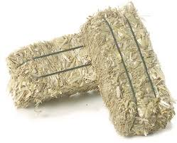









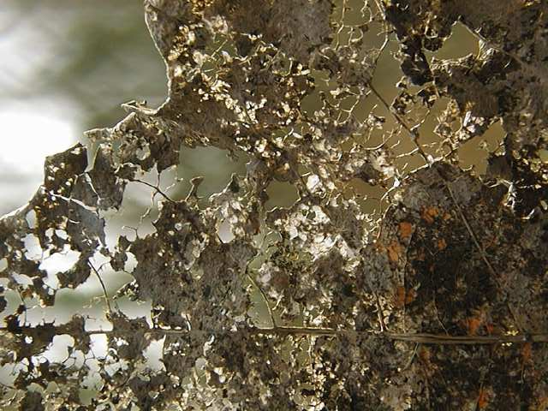
Exercise 4.2: The Biodepth experiment
1
2
4
8
16
http://www.esapubs.org/archive/mono/M075/001/suppl-1.htm
Notes:
Does biodiversity contribute to ecosystem services?
Widespread appreciation of the importance of this question, and its potential to link diversity to benefits for human society, led to the establishment of a number of biodiversity experiments in the 1990s, and there are still more being done today. These experiments followed a fairly standard protocol, where a species pool was established and then different numbers of species were randomly drawn from this pool to establish experimental communities with different numbers of species. Various ecosystem processes, like biomass production, both above and below ground, nutrient uptake and decomposition were measured in the plots in order to determine if these processes were enhanced at high diversity.

Slide 22
Exercise 4.2
The biodepth experiment attempted to understand how species richness affected ecosystem functioning in grassland communities, using a repeated sampling design in blocks at several locations in Europe. Here we only consider the effect of species richness on biomass production.
Load the Biodepth data (Biodepth.csv) and fit a mixed-effects model to answer the following questions:
What is the relationship between biomass and log diversity?
Does this relationship vary among sites?
Check the diagnostics of the model – are there ways in which you might want to improve it
Ps – there is a problem with the data that will need fixing before you can finish this correctly (clue – we are looking at nested designs!!)

Slide 23
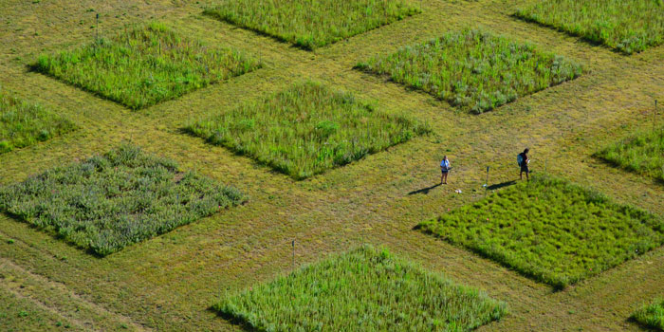
Nested random effects
Case: y ~ x₁ + (1|z₁/z₂) + ε
Property: levels of inner random effect (z₂) only occur in one level of outer random effect (z1)
Design: Growth ~ Treatment + (1|Country/Block)
Treatments (x₁)
Blocks (Z₂)
Country (Z₁)
! Every block must have a unique ID

Slide 24
A crossed random effects problem Effects of soil type on Shorea growth
x10 plots on each soil type!
Alluvial
Mudstone
Sandstone
14 species of Shorea seedlings used
Species occur unevenly across plots
Notes:
Comparing different model designs:
http://conjugateprior.org/2013/01/formulae-in-r-anova/

Slide 25
Crossed random effects
Case: y ~ x₁ + (1|z₁) + (1|z₂) + ε
Property: Random effects are not strictly nested
Design: Growth ~ Soil + (1|Species) + (1|Plot)
14 species of seedlings
Species found across plots
species and plots are random effects
x10 plots on
each soil type
Alluvial
Mudstone
Sandstone

Slide 26
Exercise 4.3
Read in and analyse the data in the file plantsoil.csv.
Check the diagnostics.
Is there an effect of soil type on plant growth?
Which soil supports the highest growth rate?
Which has the lowest growth rate?
Do differences in growth between species across soil types explain a significant amount of variation in the data?
Notes:
Last question here means : asking this for different types of model. Remake model with random sloped model

Slide 27
End of Lecture 4

